Slide 1
HTML Light

Slide 2

Let's Learn the Language

Slide 3
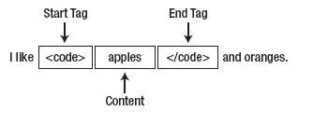
Markup Means Tags
HTML Element
Start tag, content, end tag
Element names are not case sensitive, but lower case more readable.
HTML Document
Must be the first thing in an HTML document
Defines the document type

Slide 4
Basic Tags
Element | Description
DOCTYPE | Must be the first tag in an HTML document. <!DOCTYPE html>
html | Container of all HTML elements except DOCTYPE. Tells the browser that the page is an HTML document.
head | Defines the document's head; i.e., the invisible portion of document. Contains title tag (required) and meta tags, style tags, script tags…
title | Defines the web page title. Used to define the title of the browser window, provide a title for search engines as well as bookmarks
body | Defines the document's body; i.e., the visible portion of a document.
a | Defines a hyperlink.
hr | The "horizontal rule" places a line across the page. Defines a "thematic break" or shift in content type.
p | Defines a paragraph, generally with white space above and below.
img | Defines an image in a HTML page.

Slide 5
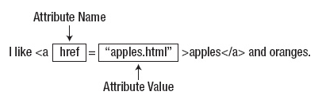
Elements, Tags and Attributes
Most HTML elements are containers: they contain content for display and have opening and closing tags:
<p>This text is defined as a paragraph.</p>
Some HTML elements are not containers (known as "void elements"); the opening tag and closing tag are combined into one tag:
A line will appear between foo <hr /> and bar.
HTML elements also contain attributes, enclosed in quotation marks.
Multiple attributes possible: <img src="cat.jpg" alt="My cat" />
Attribute
order does
not matter

Slide 6
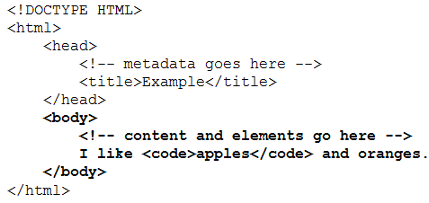
Parents, Children, Descendants, Siblings
HTML elements have defined relationships with the other elements in an HTML document.
An element that contains another element is the parent of the second element.
Relationships
<body> is parent to <code>
<code> is a child of <body>
<html> is parent to both <head> and <body>
<head> and <body> are siblings of one another
<head>, <body>, <title> and <code> are descendants of <html>
Only <head> and <body> are children of <html>

Slide 7


Well Formed HTML
An interior element cannot end after the exterior element.
Technically, you don't need to end tags that have no </ > counterpart
<img src="logo.gif" alt="Acme Logo">
<img src="logo.gif" alt="Acme Logo" /> ← better, XHTML & XML compliant
CORRECT
INCORRECT

Slide 8
Common HTML Coding Errors
An opening tag without a closing tag.
Misspelled tag or attribute names.
Quotation marks that aren’t paired.
Incorrect file references in link, img, or <a> elements.

Slide 9
A Simple HTML Document

Slide 10
Text Elements
Element | Description
a | Hyperlink.
b | Offsets a span of text without additional emphasis or importance. Formerly, "bold"
br | Line break
cite | Citation; title of another work
del | Deleted text
dfn | Definition of a term.
em | A span of text with emphatic stress.
i | A span of text that is different from the surrounding words, such as Latin species and family names. Formerly, "italics"
ins | Inserted text
Element | Description
mark | Highlighted text because of its relevance in another context.
q | Quoted text
small | Fine print
span | Used to apply global attributes, like style, or class, or hidden
strong | Used to mark important text
sub | Subscript
sup | Superscript
time | A time or a date
u | Offsets a span of text without additional emphasis or importance. Formerly, "underline"

Slide 11
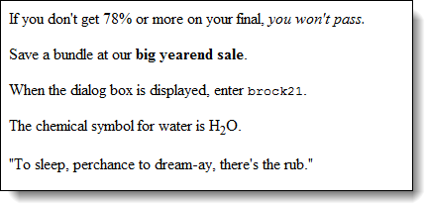
Some Sample Text Elements

Slide 12
Grouping Elements
Element | Description
dl | A definition list containing terms and definitions
dt | A defined term within a definition list
dd | A definition within a definition list
hr | "Horizontal Rule," now known as a "thematic break" (e.g. for a scene change in a movie, or a new topic within a section of a reference book
ul | An unordered list of items
ol | An ordered list of items
li | A list item in an unordered list or an ordered list (... or a menu)
p | Paragraph

Slide 13
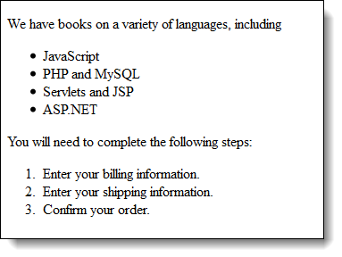
Ordered and Unordered Lists

Slide 14
Nested Lists (1)
A list within a list item

Slide 15
Definition Lists (sometimes called Description Lists)

Slide 16
Section Elements
Element | Description
address | Contact information for a document or article
article | An independent block of content
aside | Content only tangentially related to the surrounding content
header | A header region
footer | A footer region
h1, h2, h3, h4, h5, h6 | A heading. Begin with h1 and then h2 (sub heading), then h3 (sub sub heading), and so on.
nav | Groups navigation elements
section | A significant concept or topic
details | A section which can be expanded to show more details
summary | The title and/or description for corresponding <details>

Slide 17
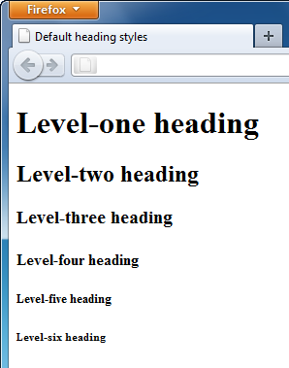
Heading Tags
Headings have multiple levels
<h1>Level-one heading</h1> <h2>Level-two heading</h2> <h3>Level-three heading</h3> <h4>Level-four heading</h4> <h5>Level-five heading</h5> <h6>Level-six heading</h6>
Although tempting, do not use <h2> tag if there is no <h1> just to get a smaller font size. Search engines pay more attention to <h1>s
Examine http://jackmyers.info/html/HeadingsAsSectionElements.html

Slide 18
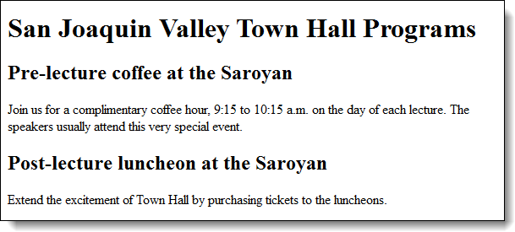
Sample HTML Using Heading and Paragraph Tags

Slide 19
Tables
Every table must have, at a minimum, the following tags:
<table> Defines the table
<td> Table Data. Defines a cell
<tr> Table Row. Defines a row
Columns are defined by the number of <td>'s within a <tr>
<table>
<tr> <td>Column 1</td> <td>Column 2</td> <td>Column 3</td> </tr> <tr> <td>Also column 1</td> <td>Also column 2</td> <td>Also column 3</td> </tr>
</table>

Slide 20
<th>
Tables will automatically size for you.
<th> for a table header (column headings)
<table>
<caption>Quarterback Passer Ratings <br />(4 Nov 2012)</caption>
<tr>
<th> Quarterback </td> <td> Team </td> <td> Passer Rating </td>
</tr>
<tr><td> Peyton Manning </td> <td> DEN </td> <td> 109.0 </td></tr>
<tr><td> Aaron Rodgers </td> <td> GB </td> <td> 107.9 </td></tr>
<tr><td> Matt Ryan </td> <td> ATL </td> <td> 103.0 </td></tr>
<tr><td> Kevin Kolb </td> <td> ARI </td> <td> 86.1 </td></tr>
<tr><td> Michael Vick </td> <td> PHL </td> <td> 78.6 </td></tr>
</table>

Slide 21
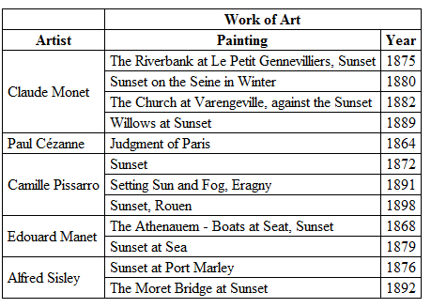
Spanning Rows or Columns
"Work of Art" spans two columns
<th colspan="2"> Work of Art</th>
"Claude Monet" spans four rows
<td rowspan="4"> Claude Monet</td>

Slide 22

Example of <img>
Images in figures
Images often work very well when embedded in <figure> and labeled with <figcaption>.

Slide 23



Image Formats
Generally, you want your GIFs to be transparent. Old shareware version of GIF Construction Set.

Slide 24
Style
Adding style is easy
Use the <style> attribute
<h1 style=“background-color: green;”>
<p style=“font-size: 14pt;”>
<td style=“color: red; font-family: Calibri; font-size: 10pt;””
You need to follow this format
Style element: value;
Enclose the entire style in quotations

